Slide 1

OPERATING SYSTEMS
Operating-System Services, Design and Implementation
Venkatesh Prasad
Department of Computer Science

Slide 2

OPERATING SYSTEMS
Slides Credits for all PPTs of this course
The slides/diagrams in this course are an adaptation, combination, and enhancement of material from the following resources and persons:
Slides of Operating System Concepts, Abraham Silberschatz, Peter Baer Galvin, Greg Gagne - 9th edition 2013 and some slides from 10th edition 2018
Some conceptual text and diagram from Operating Systems - Internals and Design Principles, William Stallings, 9th edition 2018
Some presentation transcripts from A. Frank – P. Weisberg
Some conceptual text from Operating Systems: Three Easy Pieces, Remzi Arpaci-Dusseau, Andrea Arpaci Dusseau

Slide 3
Operating systems
Operating-System Services
Venkatesh Prasad
Department of Computer Science

Slide 4
OPERATING SYSTEMS
Services
Operating systems provide an environment for execution of programs and services to programs and users
One set of operating-system services provides functions that are helpful to the user:
User interface - Almost all operating systems have a user interface (UI).
Varies between Command-Line (CLI), Graphics User Interface (GUI), Batch
Program execution - The system must be able to load a program into memory and to run that program, end execution, either normally or abnormally (indicating error)
I/O operations - A running program may require I/O, which may involve a file or an I/O device

Slide 5
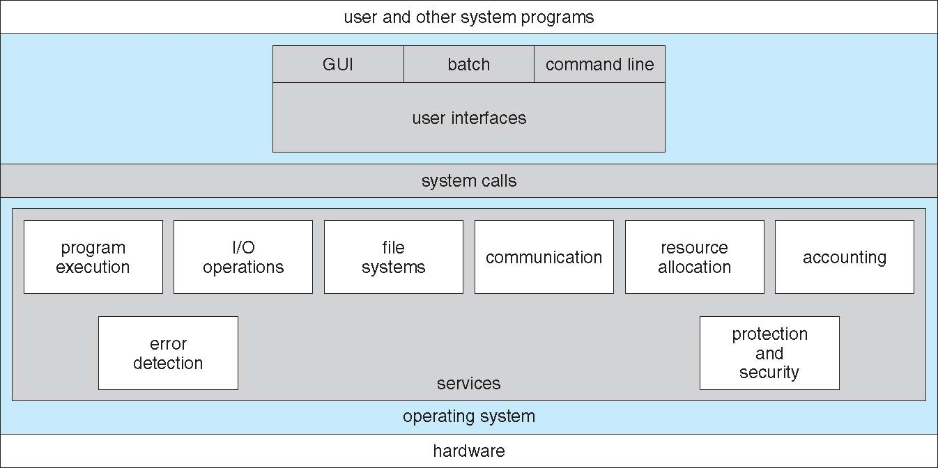
OPERATING SYSTEMS
A View of Operating System Services

Slide 6
OPERATING SYSTEMS
Services
One set of operating-system services provides functions that are helpful to the user:
File-system manipulation - The file system is of particular interest. Programs need to read and write files and directories, create and delete them, search them, list file Information, permission management.
Communications – Processes may exchange information, on the same computer or between computers over a network
Communications may be via shared memory or through message passing (packets moved by the OS)

Slide 7
OPERATING SYSTEMS
Services
Error detection – OS needs to be constantly aware of possible errors
May occur in the CPU and memory hardware, in I/O devices, in user program
For each type of error, OS should take the appropriate action to ensure correct and consistent computing
Debugging facilities can greatly enhance the user’s and programmer’s abilities to efficiently use the system

Slide 8
OPERATING SYSTEMS
Services
Another set of OS functions exists for ensuring the efficient operation of the system itself via resource sharing
Resource allocation - When multiple users or multiple jobs running concurrently, resources must be allocated to each of them
Many types of resources - CPU cycles, main memory, file storage, I/O devices.
Accounting - To keep track of which users use how much and what kinds of computer resources

Slide 9
OPERATING SYSTEMS
Services
Protection and security - The owners of information stored in a multiuser or networked computer system may want to control use of that information, concurrent processes should not interfere with each other
Protection involves ensuring that all access to system resources is controlled
Security of the system from outsiders requires user authentication, extends to defending external I/O devices from invalid access attempts

Slide 10
OPERATING SYSTEMS
Operating-System Design and Implementation
Design and Implementation of OS not “solvable” (i.e. no complete solutions to problems), but some approaches have proven successful
Internal structure of different Operating Systems can vary widely
Start the design by defining goals and specifications
Affected by choice of hardware, type of system
User goals and System goals
User goals – operating system should be convenient to use, easy to learn, reliable, safe, and fast
System goals – operating system should be easy to design, implement, and maintain, as well as flexible, reliable, error-free, and efficient

Slide 11
OPERATING SYSTEMS
Operating-System Design and Implementation
Important principle to separate
Policy: What will be done? Mechanism: How to do it?
Mechanisms determine how to do something, policies decide what will be done
The separation of policy from mechanism is a very important principle, it allows maximum flexibility if policy decisions are to be changed later (example – timer to prevent a user program from running too long)
Specifying and designing an OS is highly creative task of software engineering

Slide 12
OPERATING SYSTEMS
Implementation
Much variation
Early OSes in assembly language
Then system programming languages like Algol, PL/1
Now C, C++
Actually usually a mix of languages
Lowest levels in assembly
Main body in C
Systems programs in C, C++, scripting languages like PERL, Python, shell scripts
More high-level language easier to port to other hardware
But slower
Emulation can allow an OS to run on non-native hardware

Slide 13
THANK YOU
Venkatesh Prasad
Department of Computer Science Engineering
venkateshprasad@pes.edu

